Slide 1
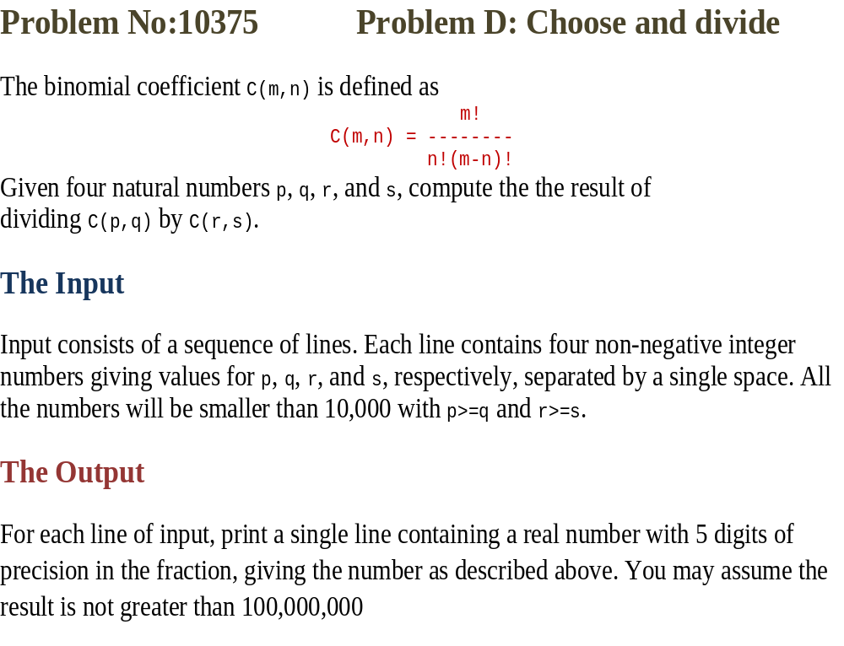

Slide 2
Sample Input
10 5 14 9
93 45 84 59
145 95 143 92
995 487 996 488
2000 1000 1999 999
9998 4999 9996 4998
Output for Sample Input
0.12587
505606.46055
1.28223
0.48996
2.00000
3.99960

Slide 3
#include<stdio.h>
int main()
{
int p, q, r, s;
double com;
long i, j;
while(4==scanf("%d%d%d%d",&p,&q,&r,&s))
{
com=1.0;
for (i=1,j=1; i<=q || j<=s; )
{
if (i<=q)
{
com=com*(p-i+1)/i;
i++;
}
if (j<=s)
{
com=com*j/(r-j+1);
j++;
}
}
printf("%.5lf\n",com);
}
return 0;
}

